Slide 1
Connected Applications in Azure
Geoff Snowman
http://geoffsnowman.codes
http://github.io/geoffsnowman
@geoffsnowman

Slide 2
For source of my sample
projects and more resources
for this presentation, see
http://geoffsnowman.codes

Slide 3
Agenda
Azure Queues
Azure Logic Application
Azure Service Bus
Azure Event Hub
Azure IoT Hub

Slide 4
Azure Storage Queues

Slide 5
Azure Queues
FIFO Storage Engine
Simple API
Scalable (although not as big as Event Hubs)

Slide 6
Azure Logic Apps

Slide 7
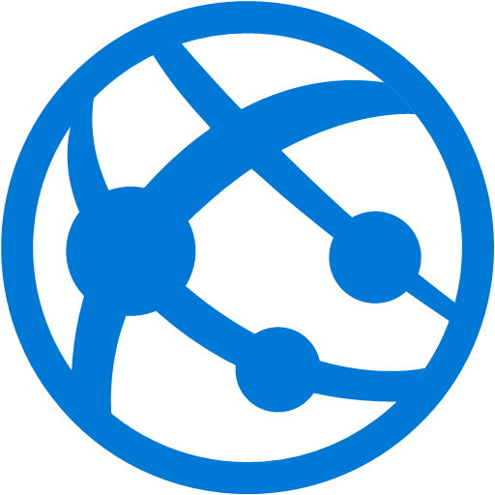
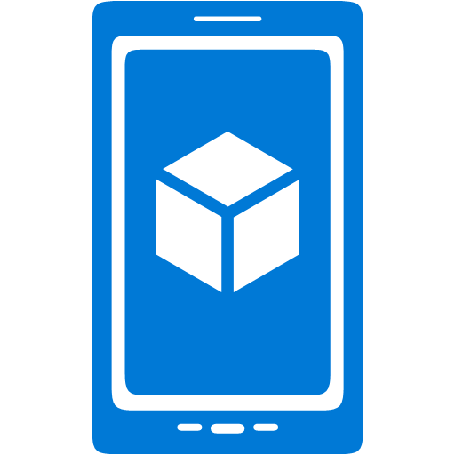
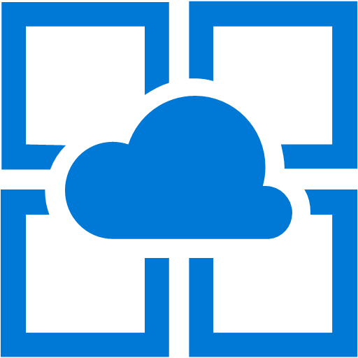


Azure App Service Family
Web Apps
Web apps that scale with your business
Mobile Apps
Build mobile apps for any device
Logic Apps
Automate business processes across SaaS and on-premises
API Apps
Build and consume APIs in the cloud
Notes:
Azure App Service is a PaaS offering that comprises four separate (but related) services:
Web Apps is a fully managed compute platform optimized to host Web sites and Web applications
Mobile Apps provides infrastructure for hosting back-ends for mobile apps -- for example, it provides infrastructure for sending push notifications not only to Windows clients, but to iOS and Android clients as well
API Apps makes it easy to host APIs in the cloud, features integrated support for Swagger (http://swagger.io/), and offers a built-in authentication service for restricting access to APIs
Logic Apps allows you to automate business processes and workflow -- for example, automatically finding negative tweets about your company and sending notifications to a Slack channel
Together, these services comprise a ready-made solution to many of the challenges involved in publishing Web sites, Web apps, Web services, mobile apps, and more.

Slide 8
Azure Service Bus

Slide 9
Service Bus
Rich Messaging API includes Queues and Pub/Sub
Service Bus for Windows Server
Strong guarantees of exactly-once delivery.

Slide 10
Storage Queues vs Service Bus
Storage queues, which are part of the Azure storage infrastructure, feature a simple REST-based Get/Put/Peek interface, providing reliable, persistent messaging within and between services.
Service Bus queues are part of a broader Azure messaging infrastructure that supports queuing as well as publish/subscribe, and more advanced integration patterns.

Slide 11
Consider Storage Queues when…
Your application must store over 80 GB of messages in a queue, where the messages have a lifetime shorter than 7 days.
Your application wants to track progress for processing a message inside of the queue. This is useful if the worker processing a message crashes. A subsequent worker can then use that information to continue from where the prior worker left off.
You require server-side logs of all of the transactions executed against your queues.

Slide 12
Consider Service Bus when…
Your solution must be able to receive messages without having to poll the queue. With Service Bus, this can be achieved through the use of the long-polling receive operation using the TCP-based protocols that Service Bus supports.
Your solution requires the queue to provide a guaranteed first-in-first-out (FIFO) ordered delivery. (Messages in storage queues are typically first-in-first-out, but sometimes they can be out of order. Storage queues guarantee at-least-once delivery. Service bus guarantees exactly-once delivery.)
You want a symmetric experience in Azure and on Windows Server (private cloud).
Your solution must be able to support automatic duplicate detection.
You want your application to process messages as parallel long-running streams (messages are associated with a stream using the SessionId property on the message). In this model, each node in the consuming application competes for streams, as opposed to messages. When a stream is given to a consuming node, the node can examine the state of the application stream state using transactions.
Your solution requires transactional behavior and atomicity when sending or receiving multiple messages from a queue.
The time-to-live (TTL) characteristic of the application-specific workload can exceed the 7-day period.

Slide 13
Consider Service Bus When…
Your application handles messages that can exceed 64 KB but will not likely approach the 256 KB limit.
You deal with a requirement to provide a role-based access model to the queues, and different rights/permissions for senders and receivers.
Your queue size will not grow larger than 80 GB.
You want to use the AMQP 1.0 standards-based messaging protocol.
You can envision an eventual migration from queue-based point-to-point communication to a message exchange pattern that enables seamless integration of additional receivers (subscribers), each of which receives independent copies of either some or all messages sent to the queue. The latter refers to the publish/subscribe capability natively provided by Service Bus.
Your messaging solution must be able to support the "At-Most-Once" delivery guarantee without the need for you to build the additional infrastructure components.
You would like to be able to publish and consume batches of messages.

Slide 14
Comparison Criteria | Storage queues | Service Bus Queues
Ordering guarantee | No For more information, see the first note in the “Additional Information” section. | Yes - First-In-First-Out (FIFO) (through the use of messaging sessions)
Delivery guarantee | At-Least-Once | At-Least-Once At-Most-Once
Atomic operation support | No | Yes
Receive behavior | Non-blocking (completes immediately if no new message is found) | Blocking with/without timeout (offers long polling, or the "Comet technique") Non-blocking (through the use of .NET managed API only)
Push-style API | No | Yes OnMessage and OnMessage sessions .NET API.
Receive mode | Peek & Lease | Peek & Lock Receive & Delete
Exclusive access mode | Lease-based | Lock-based

Slide 15
Azure Event Hubs

Slide 16
Connected Things Everywhere
NOW
More connected devices than people
%
2020
> 25 billion (Gartner predicts)
$1.7 trillion market (IDC report)
Notes:
Example Script:
Devices increasing
Devices in our world are becoming increasingly connected, and showing up in all aspects of our lives
CLICK – Retail
Stores can now use devices to for example, price check, monitor stock levels, to manage palette deliveries, and keep track of customer activities.
CLICK - Transport/Logistics
Devices on vehicles can monitor tire pressure, ensure refrigerators work, use GPS to capture and relay vehicle position or plug into the vehicle management system to relay a large amount of data that may help manage maintenance.
CLICK – Manufacturing
A manufacturing line can use connected device to ensure the efficiency, ongoing operations and quality of production.
CLICK - Smart buildings/homes
The ability to lower costs, help the environment and feedback into more efficient future designs is changing the future of our cities.
CLICK – Energy
From our national power grid to plug-in energy monitors in our homes, the data collected can improve the economics of supply energy and our understanding of how it’s used in different environments.
CLICK – Healthcare
A fitness band can be considered part of healthcare IoT, in addition to more traditional devices now turning into connected devices in hospitals.
CLICK - Vendor appliances
Grocery stores can use connected refrigerators to help ensure their produce remains fresh. Vending machine suppliers can optimize their deliveries by using connected machines.
CLICK – Mobile
Clearly the mobile phone is one of the most visible connected devices, and we’re seeing more and more personal and wearable connected devices and it’s not about to slow down.
CLICK - More devices than people
There are now more connected devices than people and…
CLICK - 25 billion by 2020
By 2020 Gartner predicts there will be more than 25 billion connected devices.
CLICK - $1.7 trillion by 2020
And by the same year, according to IDC’s report, the IoT market will grow to $1.7 trillion.

Slide 17
Event Hubs
Multi-partition capability is designed for scale at the cost of consistency.
Up to 5,000 simultaneous AMQP connections.
Specifying partition ID guarantees ordering across that partition.
Messages without partition ID are round-robined into partitions and will not necessarily be correctly ordered on delivery.

Slide 18
Consider Event Hubs When…
You have massive volumes of telemetry data, e.g. Internet of Things sensors.
You care about ordering within messages from a device.

Slide 19
IOT Hubs

Slide 20
Consider IoT Hubs When…
Even more scale than event hubs is needed.
Need bi-directional communication.
Don’t care about consistency and message ordering.

Slide 21
Comparison Criteria | IoT Hub | Event Hubs
Communication patterns | Enables device-to-cloud communications (messaging, file uploads, and reported properties) and cloud-to-device communications (direct methods, desired properties, messaging). | Only enables event ingress (usually considered for device-to-cloud scenarios).
Device state information | Device twins can store and query device state information. | No device state information can be stored.
Device protocol support | Supports MQTT, MQTT over WebSockets, AMQP, AMQP over WebSockets, and HTTP. Additionally, IoT Hub works with the Azure IoT protocol gateway. | Supports AMQP, AMQP over WebSockets, and HTTP.
Security | Provides per-device identity and revocable access control. | Provides Event Hubs-wide shared access policies. IoT solutions are often required to implement a custom solution.
Operations monitoring | Enables IoT solutions to subscribe to a rich set of events. | Exposes only aggregate metrics.
Scale | Is optimized to support millions of simultaneously connected devices. | Can support a more limited number of simultaneous connections--up to 5,000 AMQP connections.
File upload | Enables IoT solutions to upload files from devices to the cloud. | Not supported.

Slide 22
For source of my sample
projects and more resources
for this presentation, see
http://geoffsnowman.codes

